Slide 1
The Hotel Database
CCPS 510

Slide 2

The Need
Hotel management can be very complicated ie. reservations for customers, equipment availability, room status, room quality management (housekeeping)
Need to keep records for employee info, scheduling and permissions/access to rooms, and also for customer info (key card access for their room/credit card)
Conflicts - cannot reserve occupied room, cannot reserve room that has yet to be cleaned, housekeeper may not enter occupied room
Price adjustments of rooms/services
Majority of hotels use the “housekeeper room note” method

Slide 3
Our Solutions
Security feature ensuring only employees with the correct permissions/department ID can carry out specific operations
Keep employees up-to-date in a timely manner with a responsive app ie. status of room (occupied or vacant)
1
3
2
Making scheduling clear, easy, and fast. Management can adjust employee workdays , time-off, and pay
4
Clearly define relationships, displaying necessary information, maintenance ability (updating room pricing, employee info, and more)

Slide 4
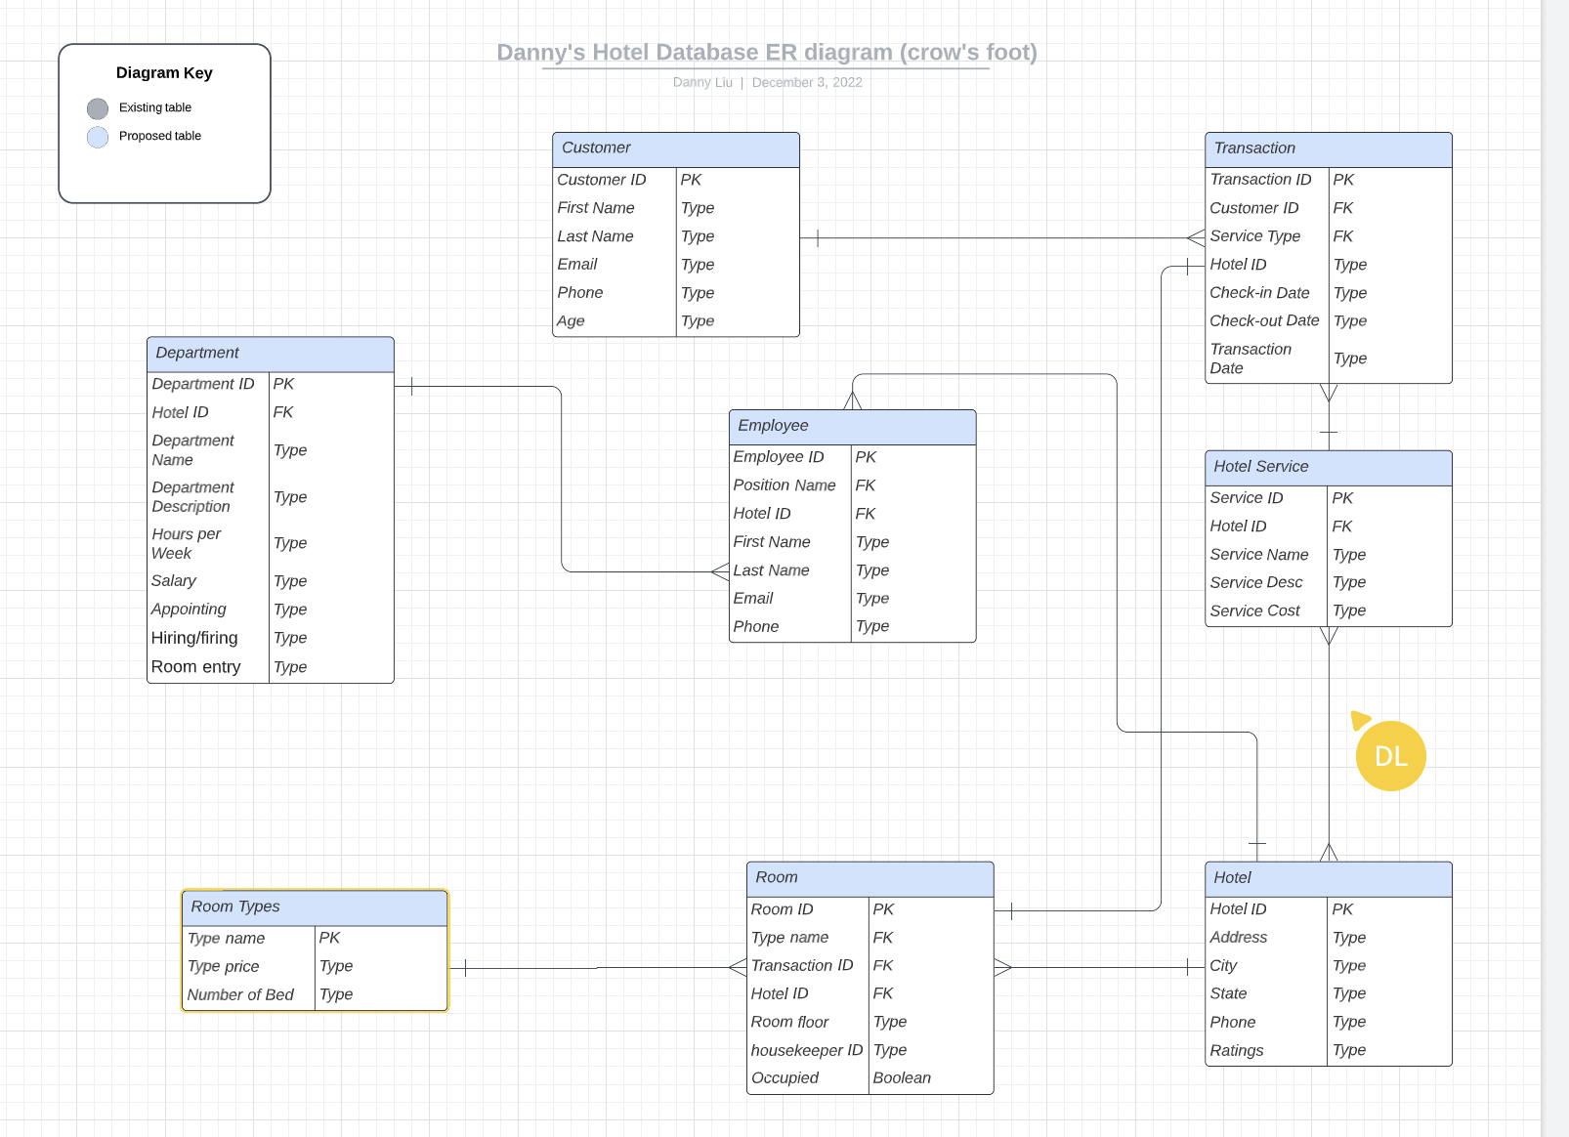
Crow’s Foot ERD

Slide 5
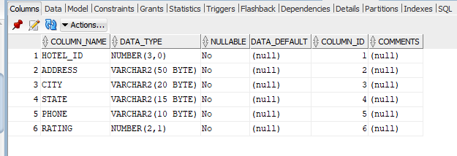
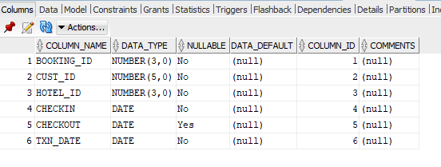
Table Creation
HOTEL Table
Booking Table
CEO
CFO
Sales Director
Berry Books
Vinny Viewer
Wendy Writer

Slide 6
Constraints
Constraints:
Customer’s age must be over 18 years old (the one in record)
Hotel rating must be between 1 to 5
Check-out date must be ahead of the Check-in date
A room must have a housekeeper
A customer record must have a credit card number

Slide 7
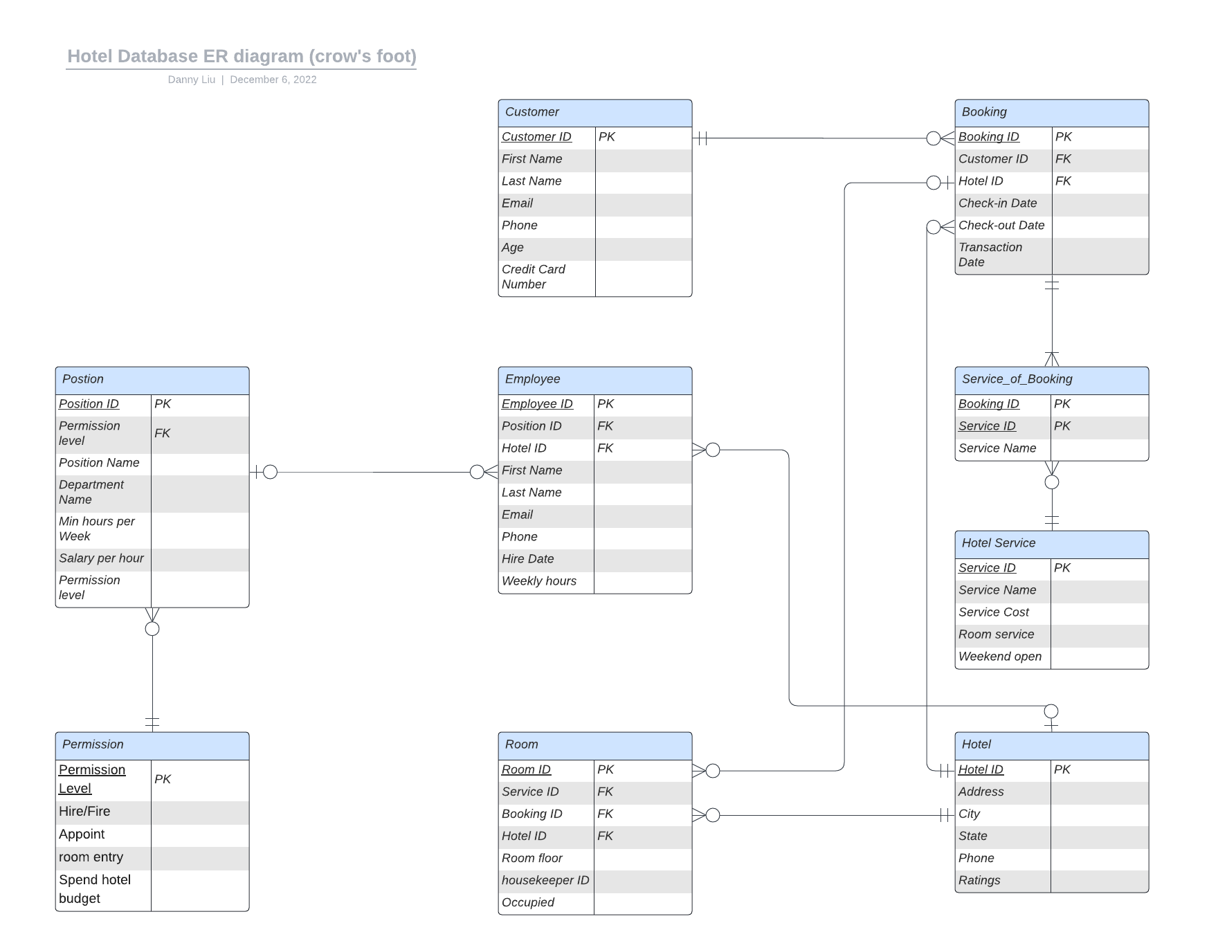
Completed ERD
Design changes:
Merge “room type” with “hotel service”
Added bridge table between Booking and Service
Modify datatype (char too short; credit_card_num is fix length )
Normalization:
Permissions depend on position(pk) and also permission level (non pk). 2f to 3f is needed to eliminate transitive dependency

Slide 8
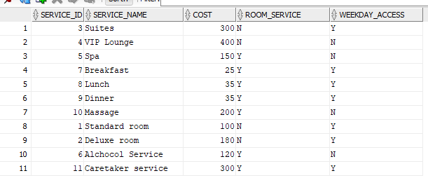
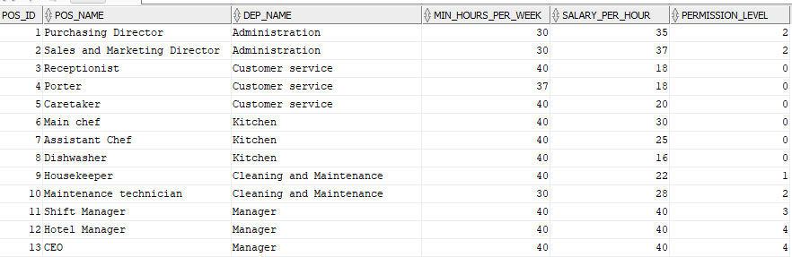
Data Insertion
Hotel Services
Hotel positions

Slide 9
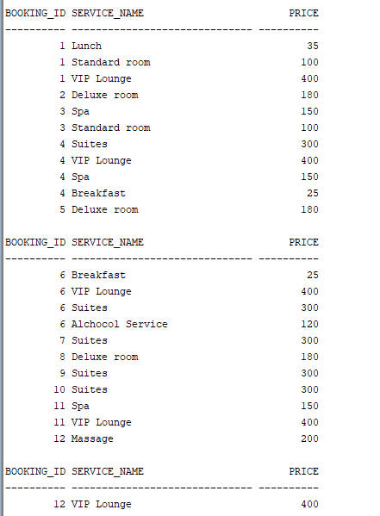
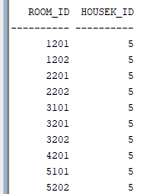
Reports
List the rooms that a housekeeper is assigned to
Allows the housekeeper to generate a list to visit the rooms that they are assigned to for the day
List all service and their price for each booking
Allow Sales and marketing director to see what services are likely to be brought together so the appropriate bundle deals can be promoted through emails or ads.

Slide 10


Accessing the Database
Usability:
Receptionist/Administration = Website
Housekeeping/Room Service = App
Stack:
Laravel + Vue.js + Flutter/Dart or
Laravel + React + React Native
Database:
MySQL
QUICK TIP
Try right clicking on a photo and using "Replace Image" to show your own photo.

Slide 11
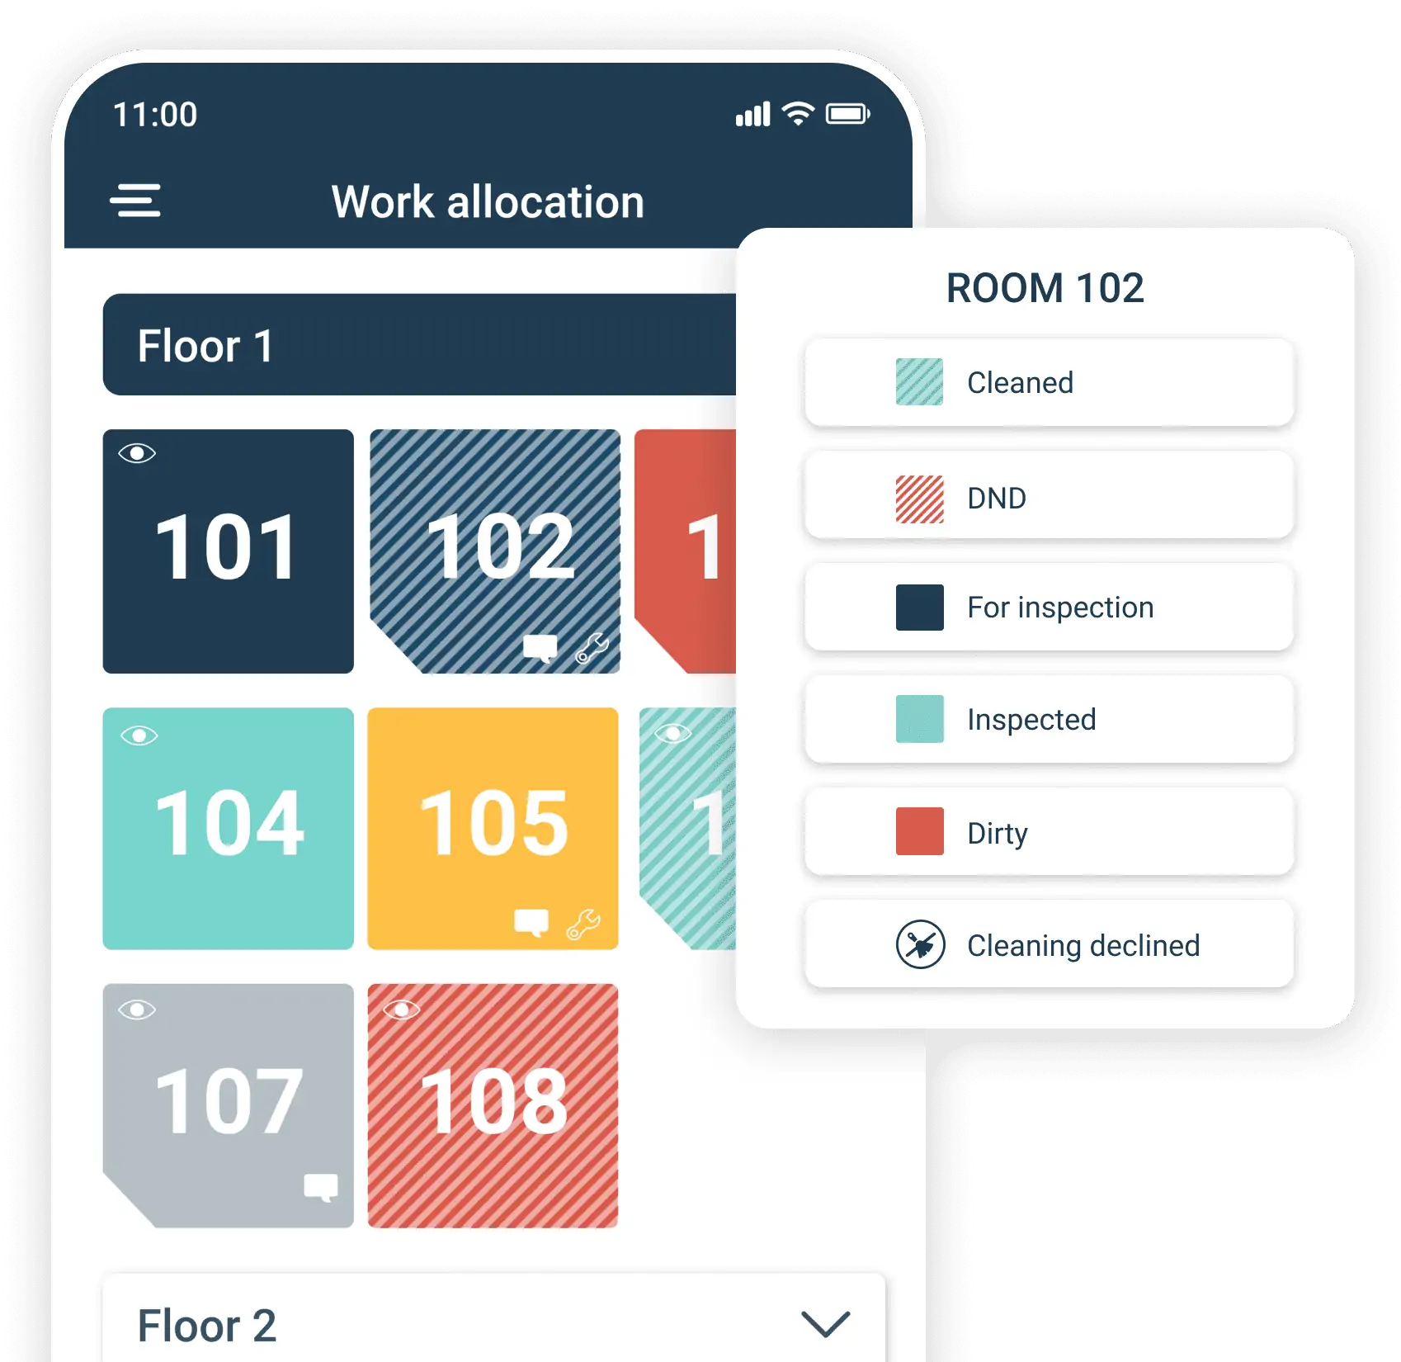
The Housekeeper’s
App
Providing housekeeper’s with fast and updated information on rooms
Reduces time wasted on knocking on doors or asking for support for messier rooms

Slide 12
Questions

